Slide 1





R. V. College of Engineering
August 2026
FalconVQA
Video QA
Natural Language Retrieval of Footage
Avinash Anish | Vaivaswat Verma

Slide 2

FalconVQA
Semantic Video Retrieval
Table of Contents
01
Introduction
06
Requirements
02
Problem Statement
07
Technology Stack
03
Why It Is Difficult
08
System Design and Flow
04
Objectives
09
Database Design
05
Methodology
10
Outcomes and Conclusion

Slide 3
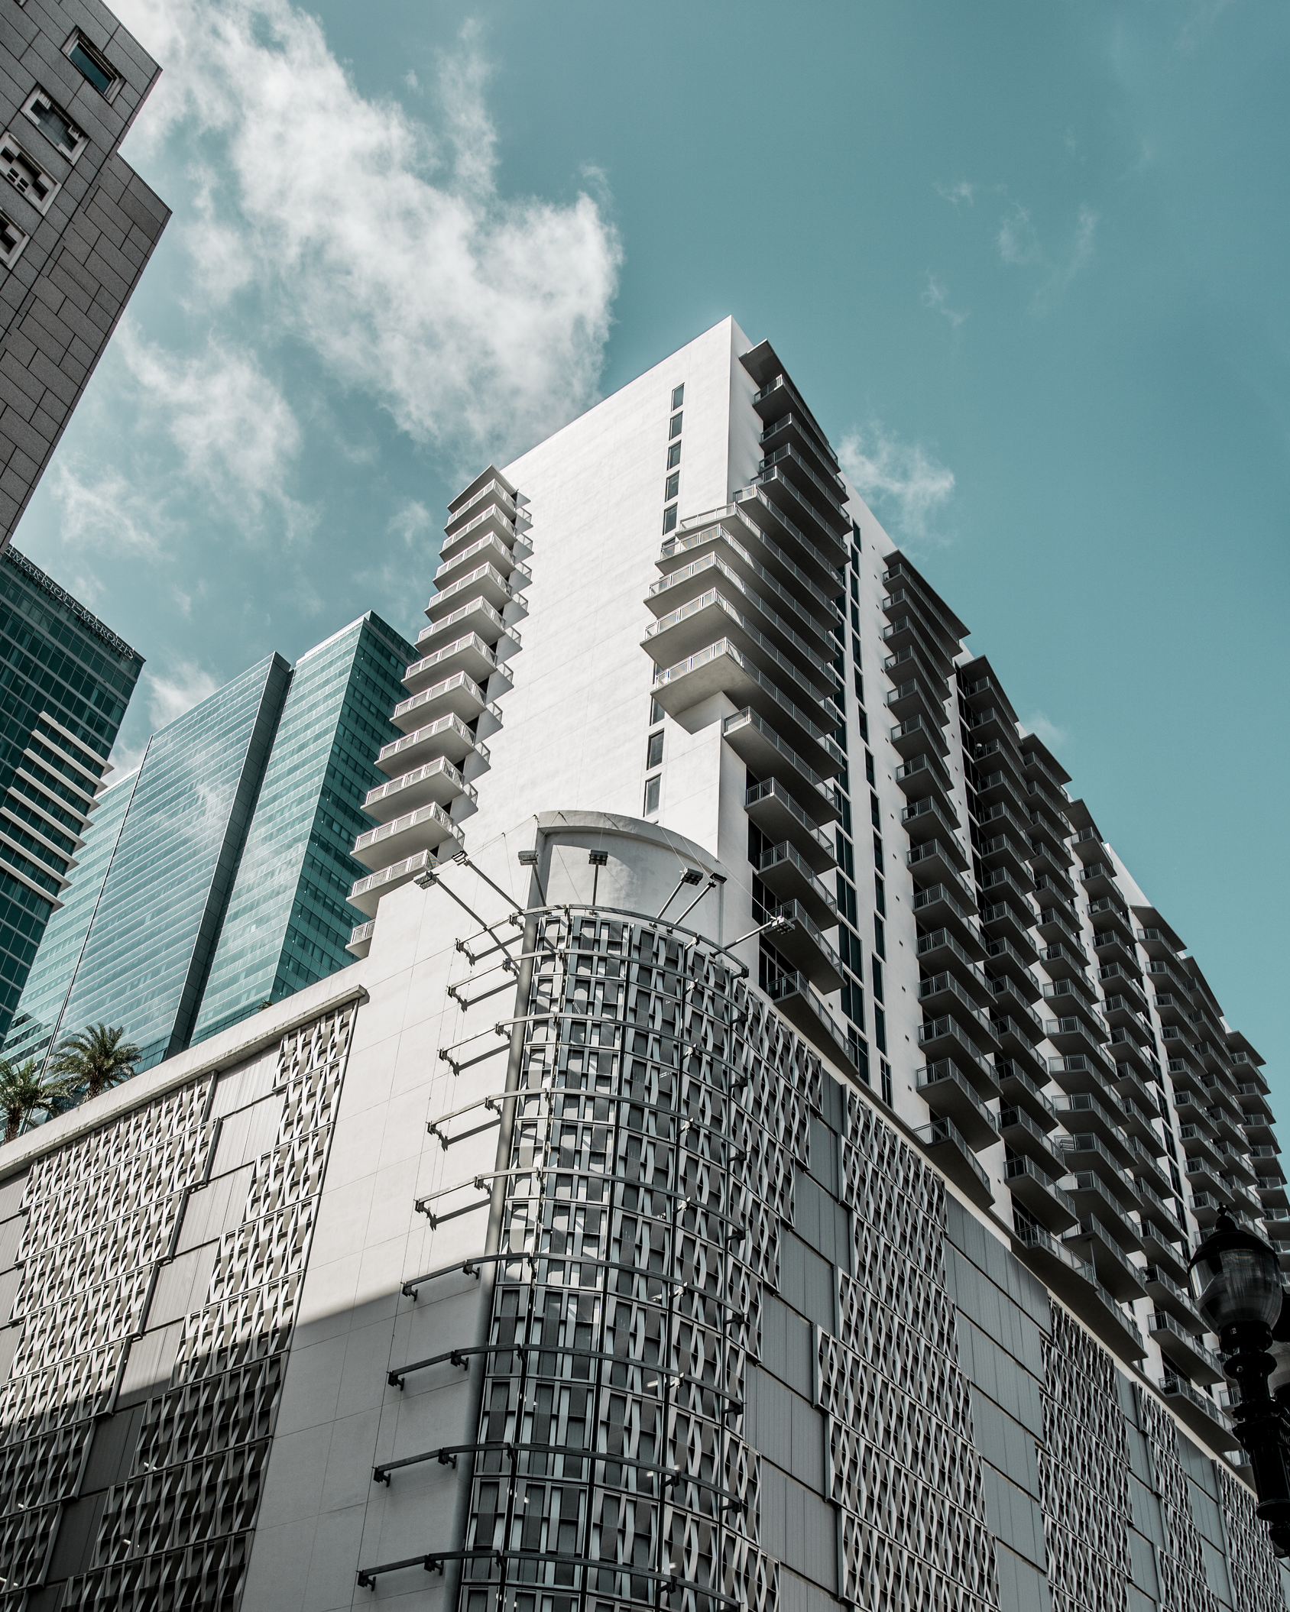
FalconVQA
Semantic Video Retrieval
Introduction
FalconVQA is a retrieval and question answering system for recorded video, developed with surveillance footage as its primary domain. It turns a continuous, unlabelled recording into an index searchable with an ordinary sentence.
The name records four properties: retrieval fast enough to be interactive, an index augmented with structured descriptions produced by vision and audio models, a language-based query interface, and a conversational path that returns cited answers.

Slide 4
FalconVQA
Semantic Video Retrieval
Indexed by a Clock
Surveillance footage is recorded onto network video recorders and indexed by nothing but a clock. Locating an incident means entering a date and time and reviewing what comes back, which works only when the time is already known.
Problem Statement
No Description
What is available in practice is an account from a witness or a report: a man in a yellow shirt left a bag near the checkout. No stage of the recording chain produces a description of the content, so such a query cannot be issued at all.
A NATURAL LANGUAGE FRONT END TO EXTRACT VIDEO FROM A RECORDED FOOTAGE BASED ON DESCRIPTION - Input a text description to semantically search and retrieve matching clips from recorded video archives using NLP and vision-language models.

Slide 5
FalconVQA
Semantic Video Retrieval
Nothing to Match
The footage carries no account of what it contains. A description has to be derived from the raw signal before any text query can be answered, and nothing in the recording chain produces one.
Manual review does not scale. One camera produces twenty-four hours of footage a day, and an archive of any size cannot be watched through to find a single moment.
General video understanding tools are built for edited media and rely on shot boundaries, speech and visually salient events. Fixed-camera surveillance footage has none of the three.
Tools Do Not Fit
Applied to such footage they return the whole recording as a single segment, or subdivide it into hundreds of near-identical ones. Neither result is searchable.

Slide 6
FalconVQA
Semantic Video Retrieval
Objectives
O-1
O-2
Design a chunking and sampling algorithm suited to continuous audio and video, so that a recording carrying no editorial structure is divided at the points where its content actually changes.
Feed the sampled frames and audio into a vision-language model under a strict output schema, and index the structured descriptions it returns as embeddings a plain-language query can match.
O-3
O-4
Deliver the complete working application: a multi-tenant workspace in which upload, progress, search, conversation and playback all take place, with each operator's recordings isolated.
Answer questions over a recording with citations to the moments the answer was drawn from, and expose every capability over a documented, self-describing HTTP API for agent use.

Slide 7
FalconVQA
Semantic Video Retrieval
Methodology
A recording passes through five stages: it is partitioned into chunks, each chunk is analysed by the selected models, the resulting records are embedded and indexed, video-level aggregates are derived from them, and the material is then queried.
Every stage is parameterised rather than fixed. Surveillance footage varies too widely for one configuration to suit all of it, so the chunking scheme and the set of analyzers are chosen per recording at upload time.
5
6
Pipeline Stages
Chunk Analyzers
Chunking, analysis, indexing, aggregation and retrieval, each validated end to end before the next was built on top of it.
Scene, people, object, on-screen text, transcription and speaker-attributed transcription, selected per recording by cost.

Slide 8
FalconVQA
Semantic Video Retrieval
Boundary Detectors
Speaker change from pyannote diarization, silence from Silero VAD, hard cuts from PySceneDetect, and semantic drift measured as cosine distance between OpenCLIP embeddings of consecutive frames sampled at 1 fps.
Chunking
Weighted Fusion
Each event contributes a Gaussian bump of width 1 s to a score curve evaluated every 0.1 s. Peaks are taken greedily above a floor of 0.12 with 2 s minimum separation. Preset, custom-weight and fixed-interval modes are offered.
Four boundary detectors run over the recording and their evidence is fused. Where a signal produces no events at all its weight is redistributed across the signals that did fire, which is what prevents fixed-camera footage from returning as a single chunk.

Slide 9
FalconVQA
Semantic Video Retrieval
Adaptive Sampling
Sampling and Analysis
Candidates are drawn at a low fixed rate and near-duplicates removed by comparing OpenCLIP embeddings. The threshold is the 40th percentile of similarity within the chunk, capped at 0.98; a fixed threshold retained one frame on a static camera.
Gated Vision Calls
YOLO11 and EasyOCR run first as gates: a frame with no detected object and no text is never submitted to the vision-language model. Surviving frames are sent as one sequence per chunk, so movement across it is described.
Six analyzers are available and are selected at upload time, since their costs differ by orders of magnitude: scene description, per-person description, object detection, on-screen text, transcription and speaker-attributed transcription.

Slide 10

FalconVQA
Semantic Video Retrieval
Indexing and Retrieval
Five Named Vectors
Each chunk is one Qdrant point carrying five separately embedded vectors: the full record, the scene description, the people, the actions and the objects. Embedding is local, with BGE-small, and a typed payload backs twelve filters.
A question is not answered by searching chunks and hoping. Each aggregate carries a short hint describing what it answers; the hints are embedded and compared with the question, and those standing a standard deviation above the mean supply the context the answer is synthesised from, with mandatory citations.
Twelve Aggregators
Video-level passes run over the saved records rather than the video, ordered by declared dependencies: statistics, novelty, summary, chapters, events, entities, timelines and co-occurrence. Re-running one costs no re-analysis.

Slide 11
FalconVQA
Semantic Video Retrieval
Functional
Register and organise recordings into projects; add footage by file or by link and choose how thoroughly it is examined; observe stage and progress per recording.
Search by description; filter by time, people, objects and speech; ask questions and receive cited answers; play any result from its timecode; drive it all over an HTTP API.
A search returns within 2 s and a question within 15 s. A recording becomes searchable within roughly three times its own duration while the operator continues working.
Non-Functional
Unedited, silent, fixed-camera footage is the normal case. Every answer cites its sources or states that none exists. Recordings are readable only by the account that owns them.

Slide 12
FalconVQA
Semantic Video Retrieval
Technology Stack
Frontend
Backend
Next.js 16, React 19, TypeScript and Tailwind CSS v4 with shadcn/ui. Zustand and TanStack Query for state, video.js and hls.js for playback, and the Vercel AI SDK v6 for the streaming agent tool loop.
Python 3.13, FastAPI and Uvicorn expose the pipeline as a self-describing HTTP API. PyTorch 2.11 on CUDA 13 with Transformers provides the model runtime, on an 8 GB CUDA-capable GPU.
Models
Data
pyannote, Silero VAD, PySceneDetect and OpenCLIP for boundaries; a vision-language model, faster-whisper, YOLO11 and EasyOCR for analysis; GLiNER and BGE-small for aggregation and embedding.
Qdrant stores one point per chunk with five named vectors. Supabase provides Postgres, authentication with row-level security, and object storage. Vercel hosts the client, a CUDA host the service.

Slide 13


FalconVQA
Semantic Video Retrieval
Ingestion Path
Query Path
The service accepts a file or a link, returns a job identifier immediately, and proceeds on a background thread through fetching, chunking, analyzing, indexing and aggregating. The client polls the job and reconciles it into the recording's row.
A description is embedded, matched against the chosen vector space under typed filters, and returned as ranked chunks with timecodes. A question is instead routed to the aggregates capable of answering it and synthesised with citations.
System Design and Flow
A three-tier system. The client owns the operator interface and multi-tenancy; the analysis service owns the pipeline and has no notion of users; persistence is divided across four stores joined by a single content hash.

Slide 14
FalconVQA
Semantic Video Retrieval
Database Design
Postgres
Storage
Accounts, projects, the recording registry, conversations and messages. Every relationship cascades on delete, and row-level security tests the owner on each relation, messages through their parent conversation.
Two buckets hold the uploaded bytes, the canonical copy the pipeline reads under the content hash, and one poster frame per recording, so a listing never decodes video to draw a thumbnail.
Records
Qdrant
One JSON document per recording holds the chunk array with one key per analyzer that produced output, plus the chunking scheme and cached aggregates. A gated-out analyzer contributes no key rather than a null.
One collection, one point per recording, analyzer, chunk span and chunk configuration. Each point carries five 384-dimensional vectors and a payload sufficient to rank, filter and cite without joining back.

Slide 15
FalconVQA
Semantic Video Retrieval
Outcomes
The pipeline runs end to end on real surveillance footage. A recording is chunked, analysed, indexed and aggregated on upload, and is then searchable by description, questionable in natural language, and playable from any result returned.
Decisions were settled by measurement rather than assumption. Weight redistribution, the adaptive similarity cap, label-free detector boxes and constrained entity linking each replaced an obvious choice observed to fail.
22x
440
Faster Frame Reads
Tokens per Search
Measured for sequential decoding against per-frame seeking, which restarts the H.264 decoder at a keyframe on every read.
A minimal response against roughly 19,000 tokens for five full hits, so a token-metered agent pays only for what it needs.

Slide 16
FalconVQA
Semantic Video Retrieval
What Was Built
Conclusion
A working application covering upload, analysis, search, question answering and playback, over a chunking and sampling algorithm designed for continuous audio and video rather than for edited media.
What Comes Next
Cross-recording person linking across a camera network, ingestion from a live feed as a rolling window, visual re-identification from the stored crops, and exposure of the API as a tool server.
The system replaces the clock as the only handle on a recording. An operator states what is being looked for in plain language and receives the moment it occurred, timestamped and ready to play.

Slide 17
R. V. College of Engineering
August 2026
Thank You
Questions and Discussion
Avinash Anish | Vaivaswat Verma

